Slide 1


Modeling Europe’s role in the global LNG market 2040
Dr. Sebastian Zwickl-Bernhard, Prof. Dr. Anne Neumann
Zwickl-Bernhard, S. and A. Neumann (2024): Modeling Europe's role in the global LNG market 2040: Balancing decarbonization goals, energy security, and geopolitical tensions. Energy, 301, 131612.
www.tuwien.at

Slide 2
LNG‘s role in the clean energy transition
A bridging technology to...
Sustain-ability
Energy Policy
Afford-ability
Supply Security

Slide 3
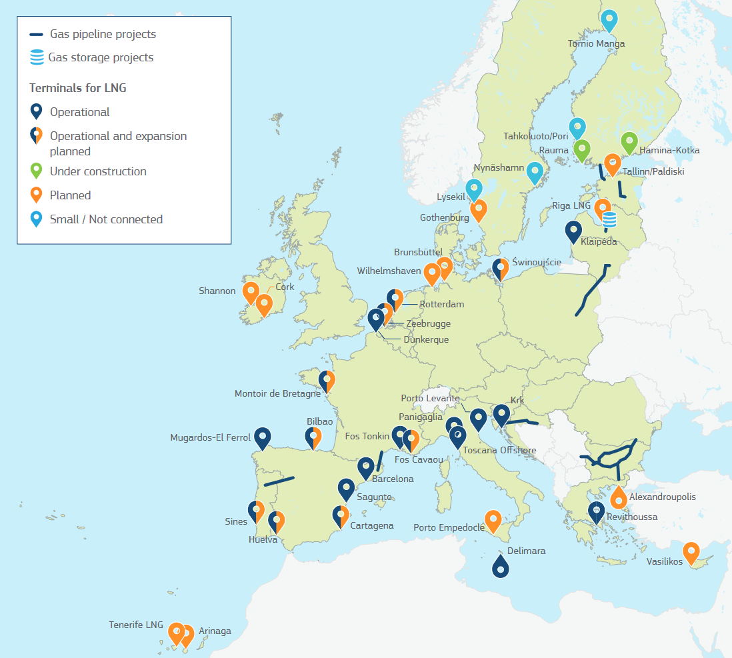
European LNG infrastructure
U.S. LNG, along with supplies from other exporters, presents a viable alternative to pipeline-based gas imports from Russia in both the short and medium term
LNG contracts are frequently associated with more flexible pricing mechanisms, in contrast to the traditional oil-indexed gas agreements that have dominated the market.
Beyond cost, environmental concerns, including methane emissions from LNG production and shipping, have raised concerns.
Source: Factsheet EU-U.S. LNG Trade, EC (2022).

Slide 4
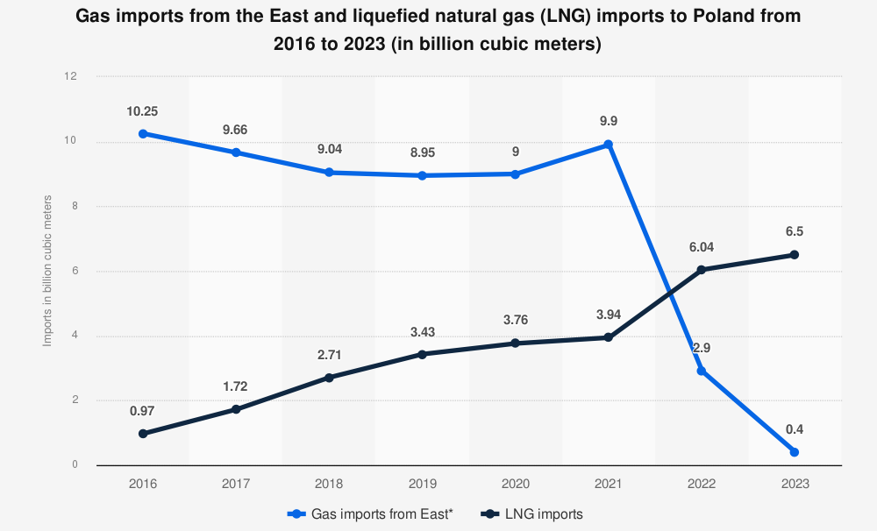
A bridging technology to...
Source: Polskie Górnictwo Naftowe i Gazownictwo, and PKN ORLEN. "Gas Imports from The East and Liquefied Natural Gas (Lng) Imports to Poland from 2016 to 2023 (in Billion Cubic Meters)." Statista, Statista Inc., 1 Mar 2024, https://www.statista.com/statistics/1003193/poland-gas-and-lng-import-s/

Slide 5
Which impact will geopolitical tensions between importing and exporting regions have on European LNG supply if global LNG trade were to be used as a political weapon?

Slide 6
Method (I)
focus on European supply and associated costs in 2040 under two scenarios
the impact of political tensions -> detailed analysis of LNG flows and supply costs for five cases
specifically looking at Europe

Slide 7
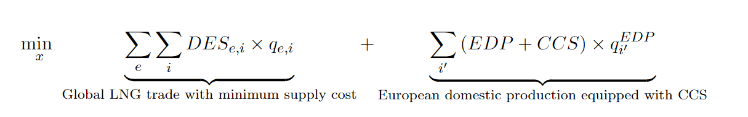
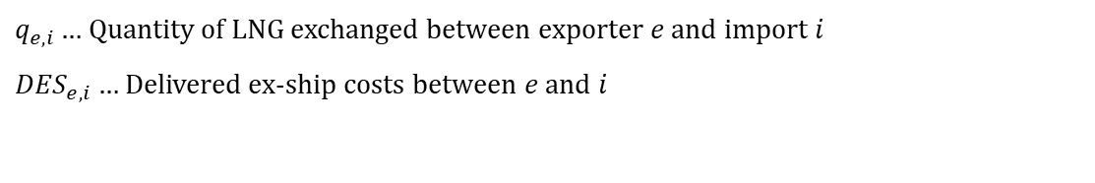
Method (II)
$q_{e,i}…$ Quantity of LNG exchanged between exporter $e$ and import $i$
${DES}_{e,i}…$ Delivered ex-ship costs between $e$ and $i$
tailor-made (and simplified) optimization model
minimizing DES costs + alternative supply
considering increasing LNG demand in developing countries
subject to six (standard) constraints

Slide 8
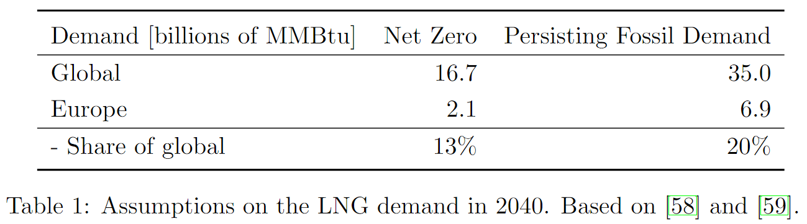
Method (III)
baseline assumptions for future demand

Slide 9
How will Europe meet its expected LNG demand in 2040 given increased global LNG demand driven primarily by developing countries?
Two possible futures.

Slide 10
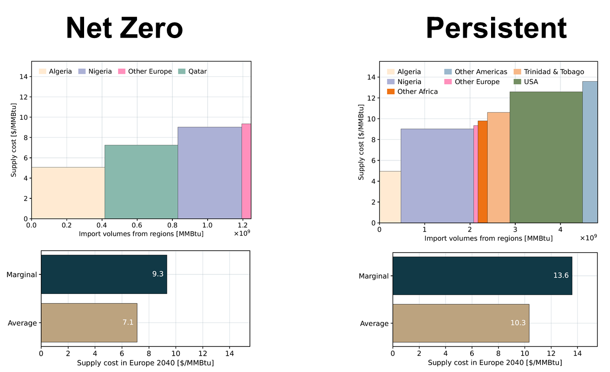

Slide 11
Which impact will geopolitical tensions between importing and exporting regions have on the European LNG supply if global LNG trade were to be used as a political weapon?

Slide 12
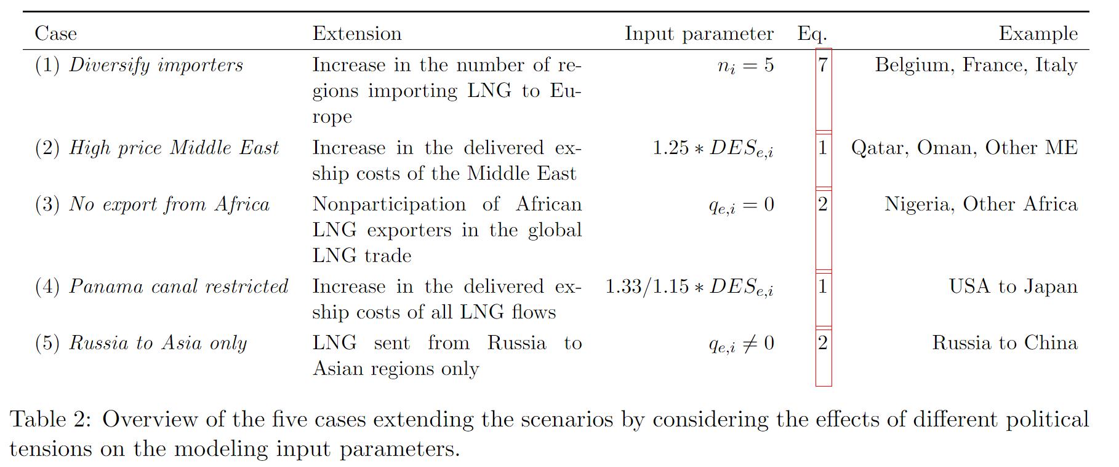
Five cases

Slide 13
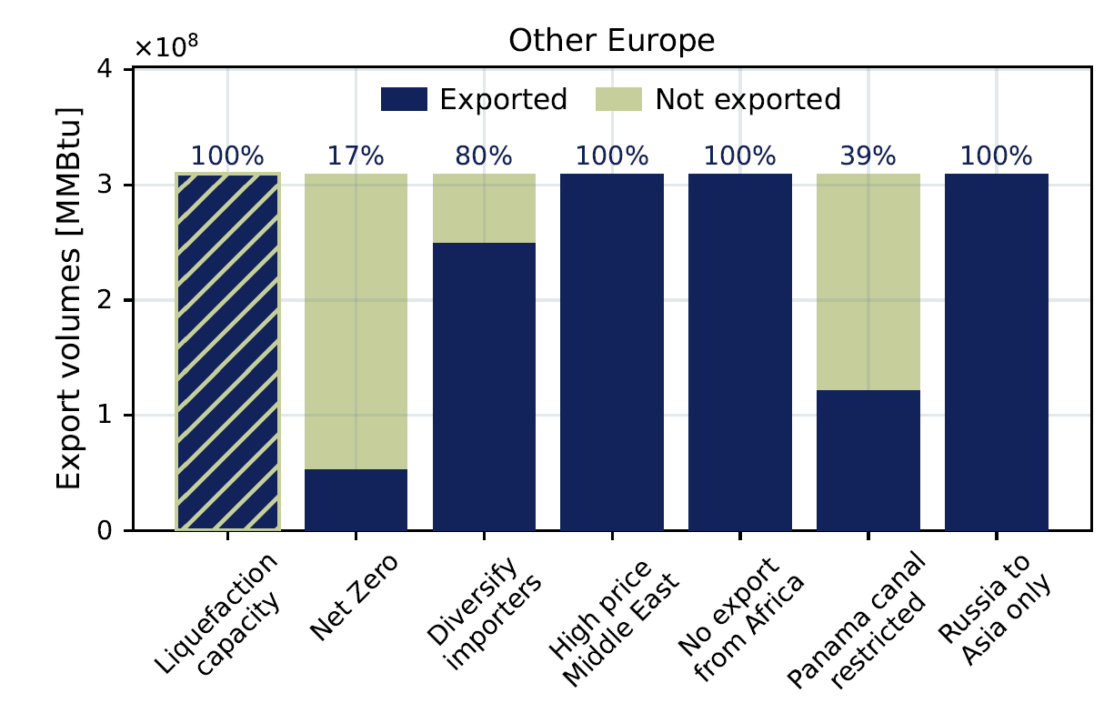
Net Zero, scenario results

Slide 14
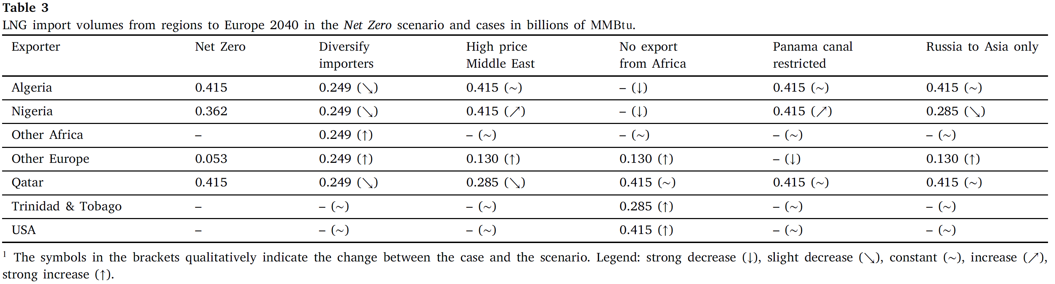
Scenario effects, net zero

Slide 15
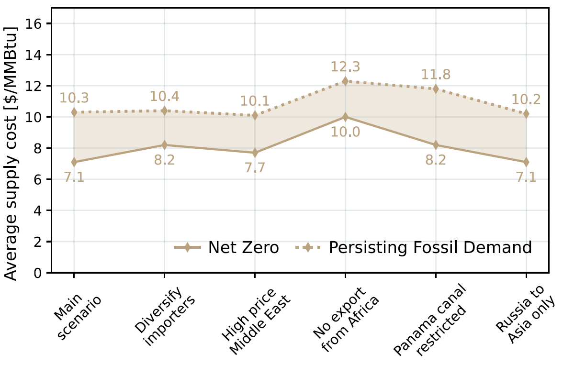
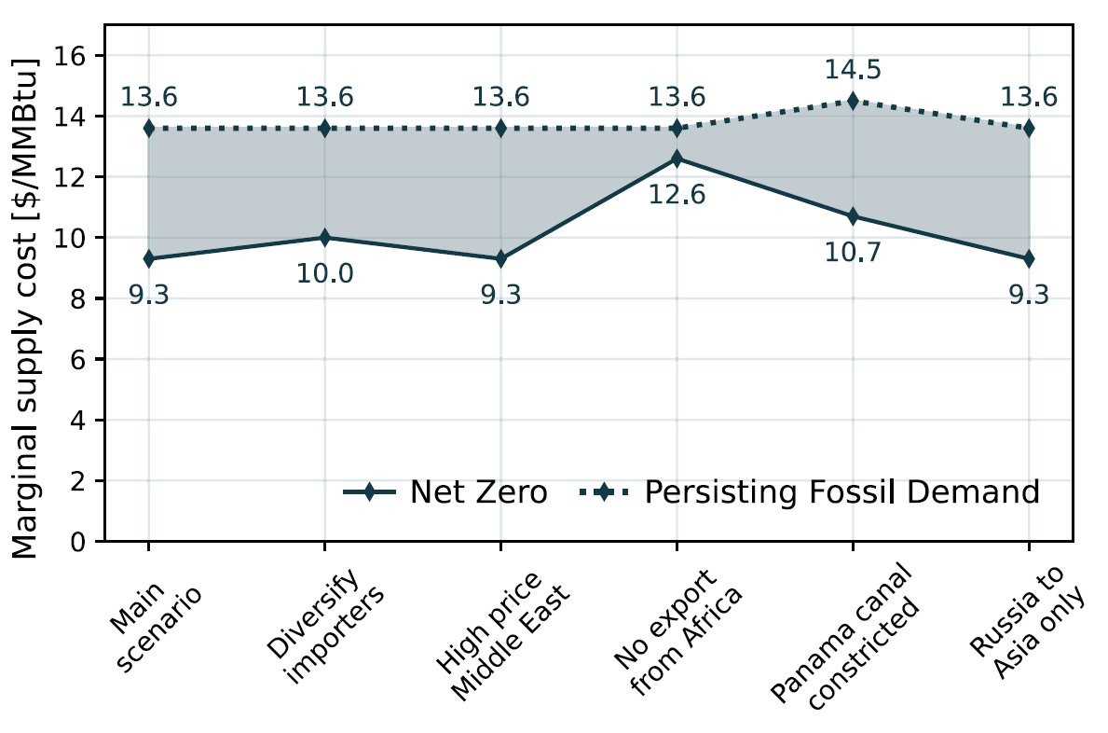
Effect on supply costs
Average supply costs to Europe in 2040
Marginal supply costs to Europe in 2040

Slide 16
Can European domestic fossil gas production combined with CCS be part of the solution for covering the demand in a decarbonized European energy system?

Slide 17
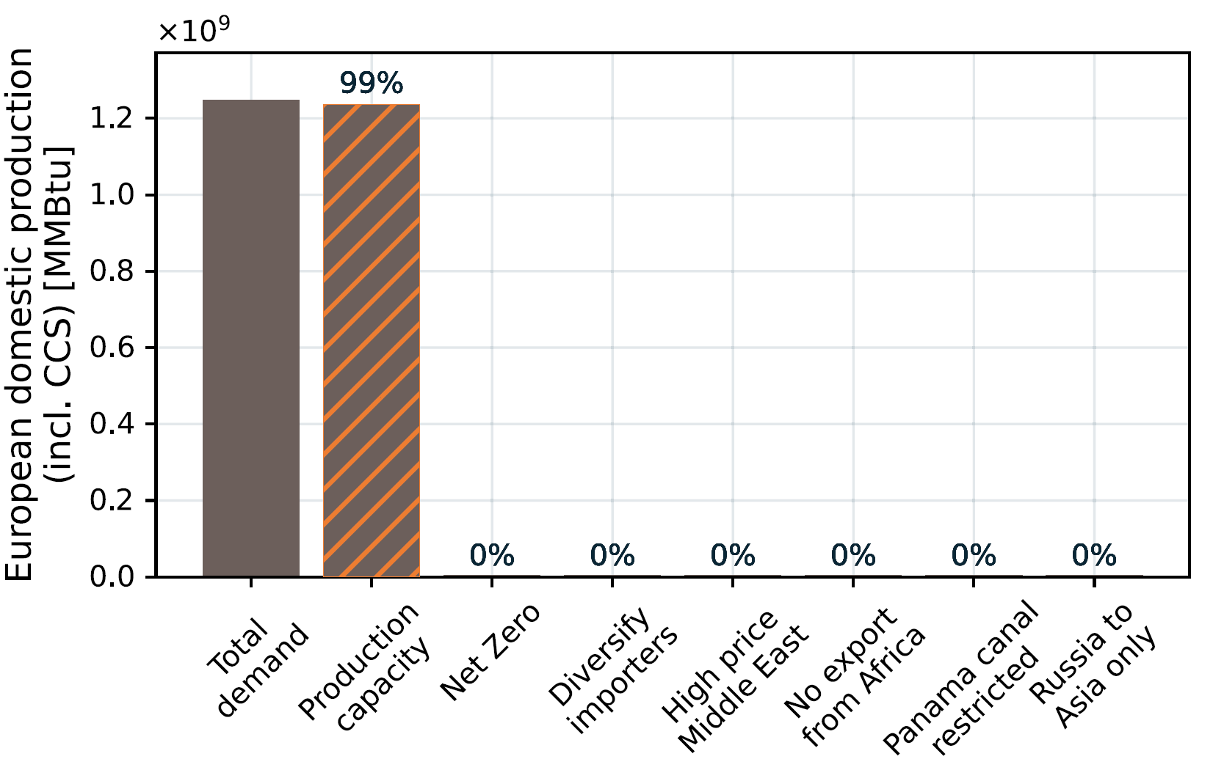
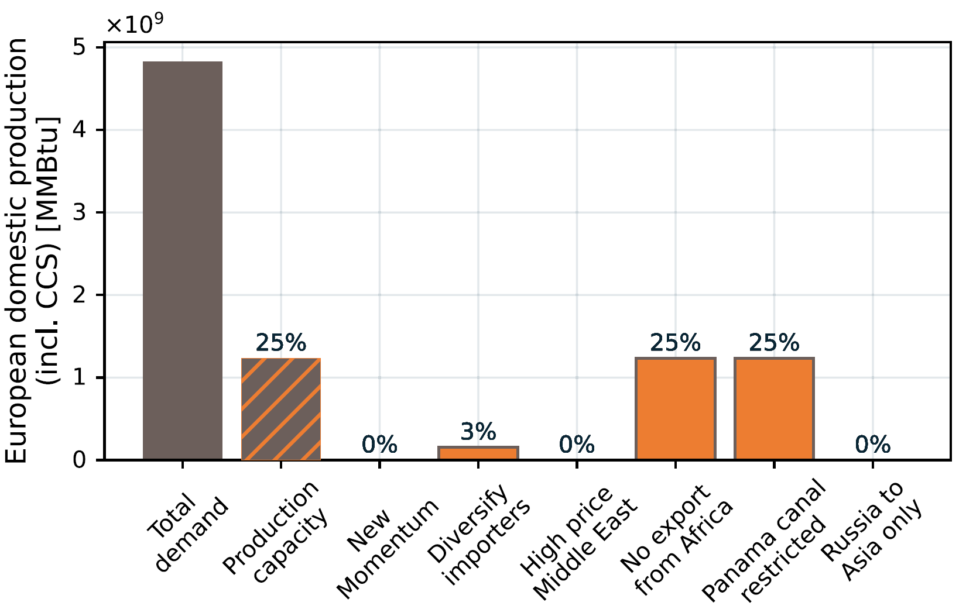
European domestic production with CCS
Net Zero
Persistent

Slide 18
Conclusions
Complexity of Europe's strategy to simultaneously meet decarbonization targets and address energy security concerns
Provide insights into the economic feasibility and implications of prioritizing domestic production over external LNG imports (CCS)
Europe has a role in the global LNG market only in an ambitious sustainable scenario
African exporters become crucial stabilizers
As global LNG demand increases, truly stable trends or patterns in trade are diminishing

Slide 19
Contact
Sebastian Zwickl-Bernhard, Ph.D.
Technische Universität Wien
Energy Economics Group
Gußhausstraße 25 – 29 / E370-03
1040 Vienna, Austria
zwickl@eeg.tuwien.ac.at

Slide 20
Back up
Back up

Slide 21
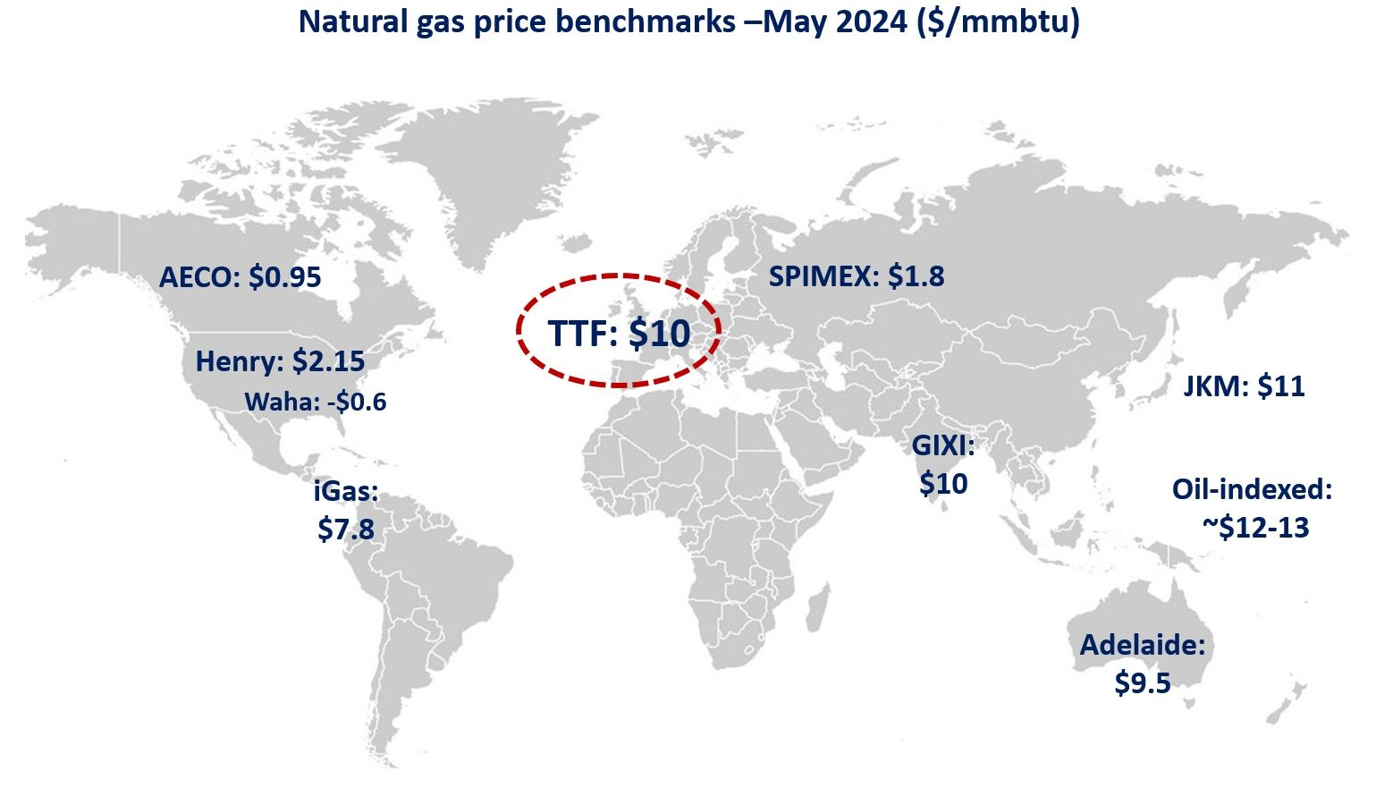
A bridging technology to...
Source: US DOE (2024)

Slide 22
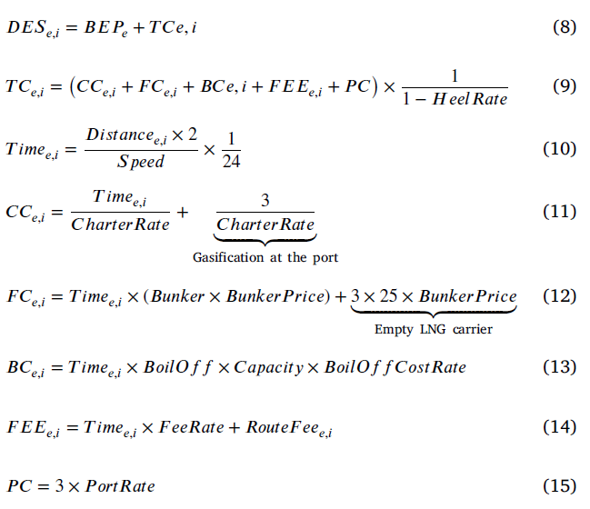
Cost function

Slide 23
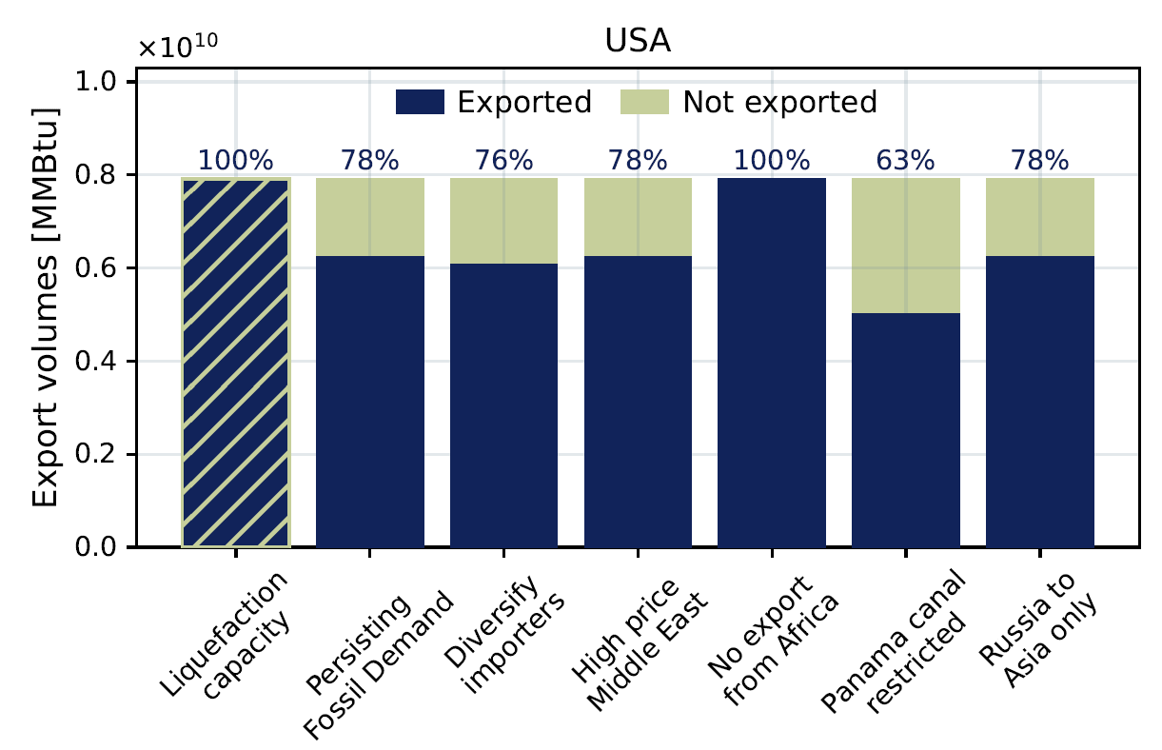
Persistent, scenario results

Slide 24
Scenario effect, Net Zero
 | Diversify imports | High price ME | No exports from Africa | Panama canal closed | Russia to Asia only
Algeria | ↓ |  | ↓↓↓
Nigeria | ↓ | ↑ | ↓↓↓ | ↑ | ↓
Other Africa | ↑↑↑
Other Europe | ↑↑↑ | ↑↑↑ | ↑↑↑ | ↓↓↓ | ↑↑↑
Qatar | ↓ | ↓
T & T |  |  | ↑↑↑
USA |  |  | ↑↑↑

Slide 25
Scenario effects, net zero

Slide 26
Scenario effects, Persistent
 | Diversify imports | High price ME | No exports from Africa | Panama canal closed | Russia to Asia only
Algeria | ↓ |  | ↓↓↓
Nigeria | ↓ | ↑ | ↓↓↓ | ↑ | ↓
Other Africa | ↑↑↑
Other Europe | ↑↑↑ | ↑↑↑ | ↑↑↑ | ↓↓↓ | ↑↑↑
Qatar | ↓ | ↓
T & T |  |  | ↑↑↑
USA |  |  | ↑↑↑

Slide 27
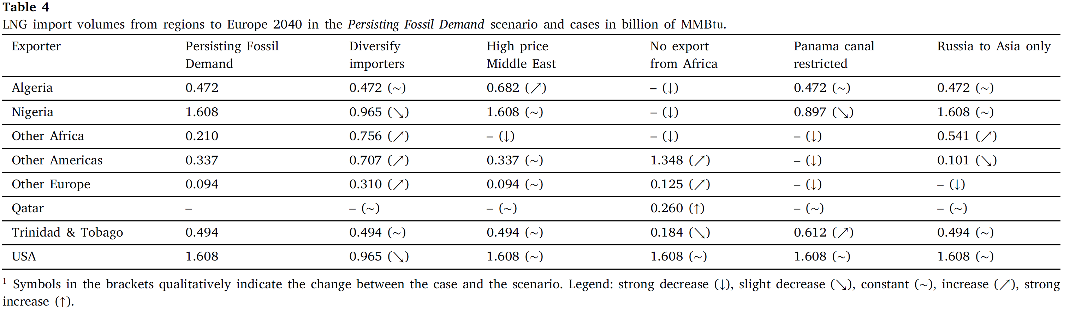
Scenario effects, persistent

Slide 28
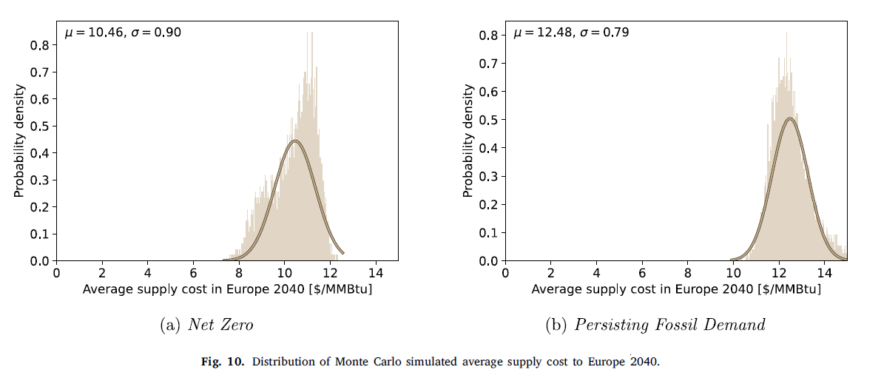
Monte Carlo, average costs

Slide 29
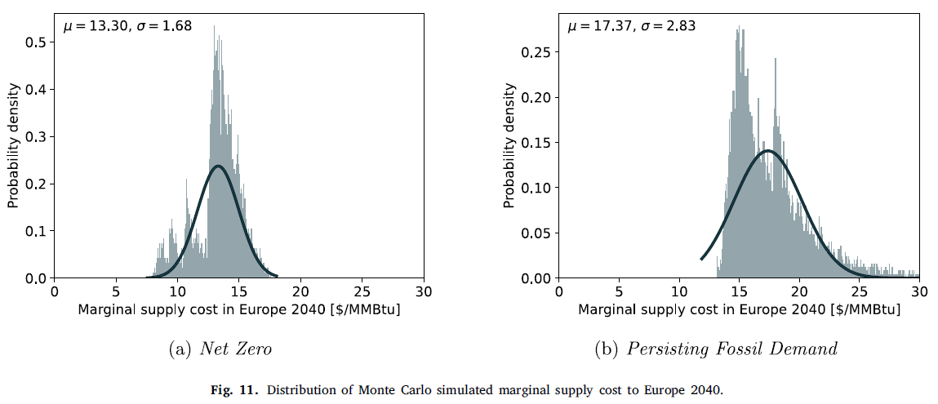
Monte Carlo, marginal costs

Slide 30
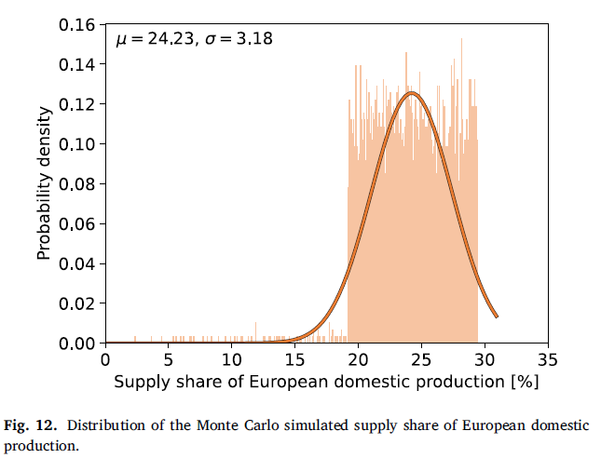
Monte Carlo, domestic with CCS

Slide 31
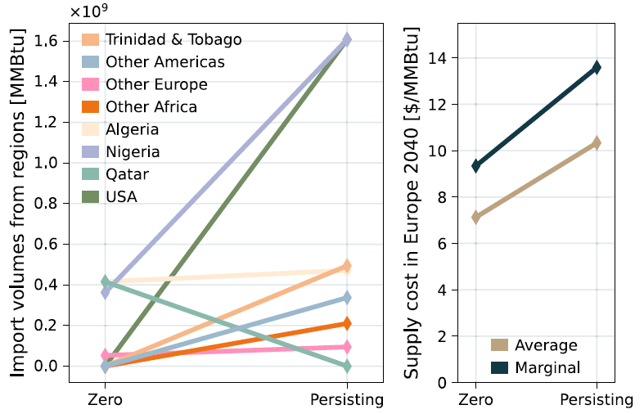
Summary of findings

Slide 32
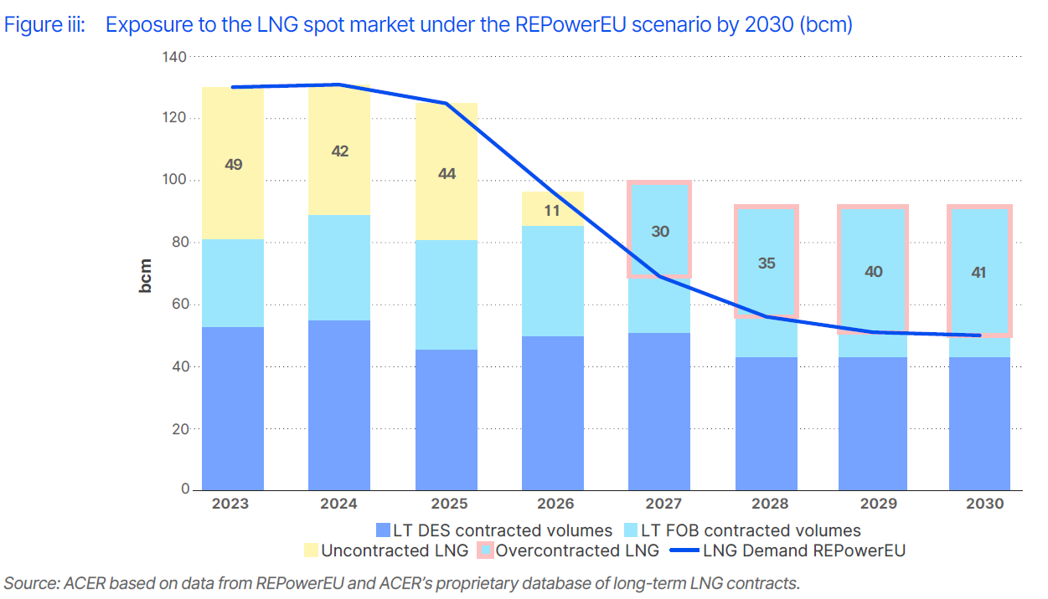
Exposure to the LNG spot market und er the REPowerEU scenario by 2030 (bcm)
Notes:
Free on Board (FOB) shipping terms in long-term supply contracts entitles LNG off-takers full flexibility to set the final destination of the LNG deliveries.

